Slide 1
Customer Sales Performance Analysis
End-to-End Data Analytics Project
Nibedita Sahu
Data Science & Analytics

Slide 2
Project Overview
The goal of the project is to perform complete Data Analysis and Visualization using SQL, Python, and Power BI, helping build a strong foundation in real-world sales data handling, visualization, and storytelling for business insights.
Data Source:
Dataset Origin: Dataset taken from Kaggle.
Dataset Details: Contains information about orders, products, customers, regions and more.

Slide 3
Tools & Techniques Used
Tools:
Pandas for data manipulation and cleaning to ensure data quality and consistency.
Matplotlib for creating static visualizations to highlight trends and patterns in the data.
Seaborn for advanced data visualization to provide deeper insights into sales performance metrics.
SQL for querying and exploring the dataset to extract relevant information.
Power BI to build an interactive dashboard for presenting findings and insights in a user-friendly format.

Slide 4
Tools & Techniques Used
Techniques:
Data Integration
Data Cleaning
Exploratory Data Analysis (EDA)
Data Validation
Statistical Analysis
Feature Engineering
Data Storytelling
Dashboard Design

Slide 5
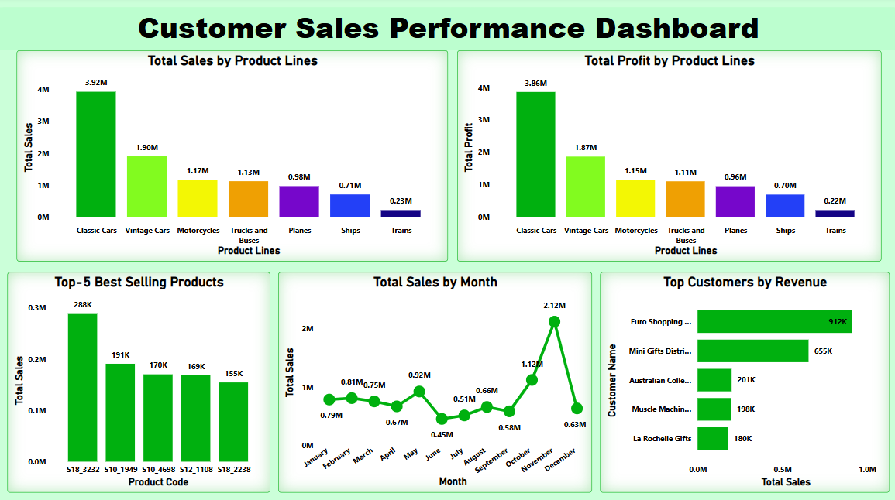
The final dashboard highlights key metrics and visual insights about sales performance across products, customers, and time.

Slide 6
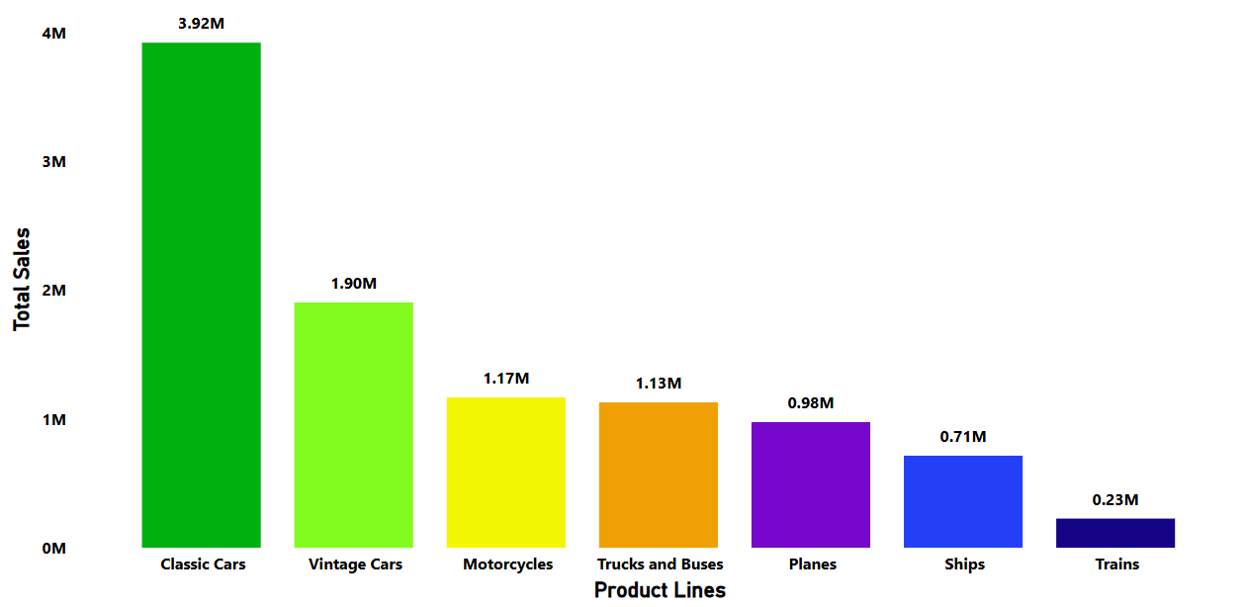
Total Sales by Product Lines
Classic Cars generated the highest revenue, followed by Vintage Cars. These categories could be prioritized in marketing strategies or stock planning to maximize sales.
Classic Cars
Vintage Cars

Slide 7

Total Profit by Product Lines
Classic Cars not only led in sales but also in overall profit, making it the most profitable category. We should focus on high-profit categories while analyzing cost-to-profit ratio for lower-performing product lines.
Classic Cars

Slide 8
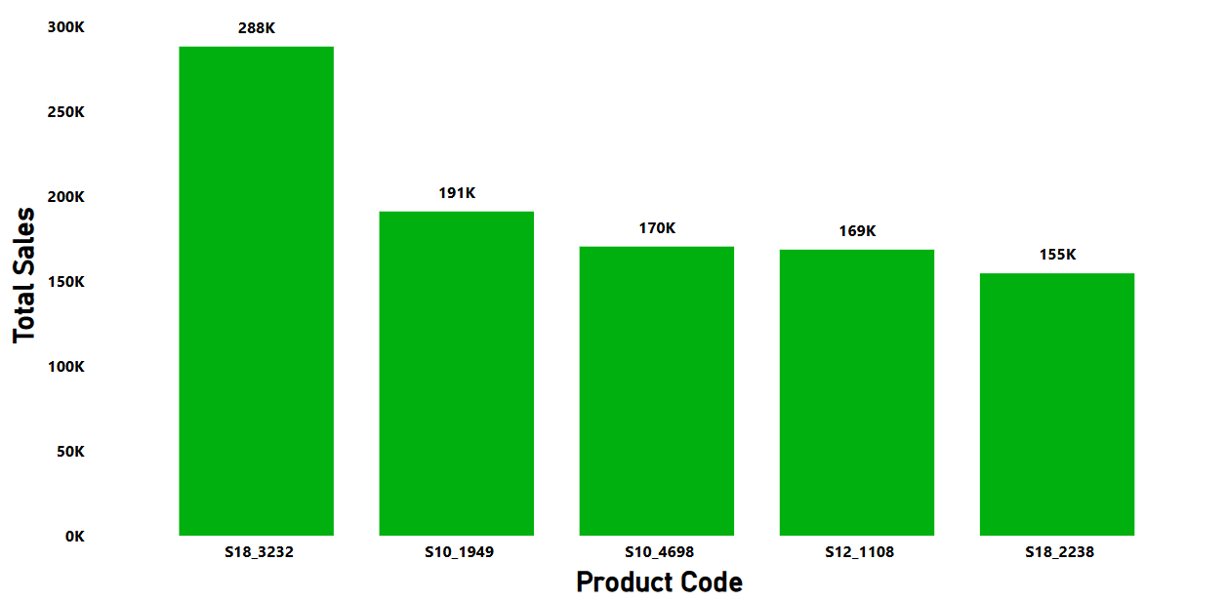
Top-5 Best-Selling Products
S18_3232 had the highest sales volumes, contributing significantly to total revenue. Top-selling products can be bundled or promoted further to drive revenue growth.
S18_3232

Slide 9
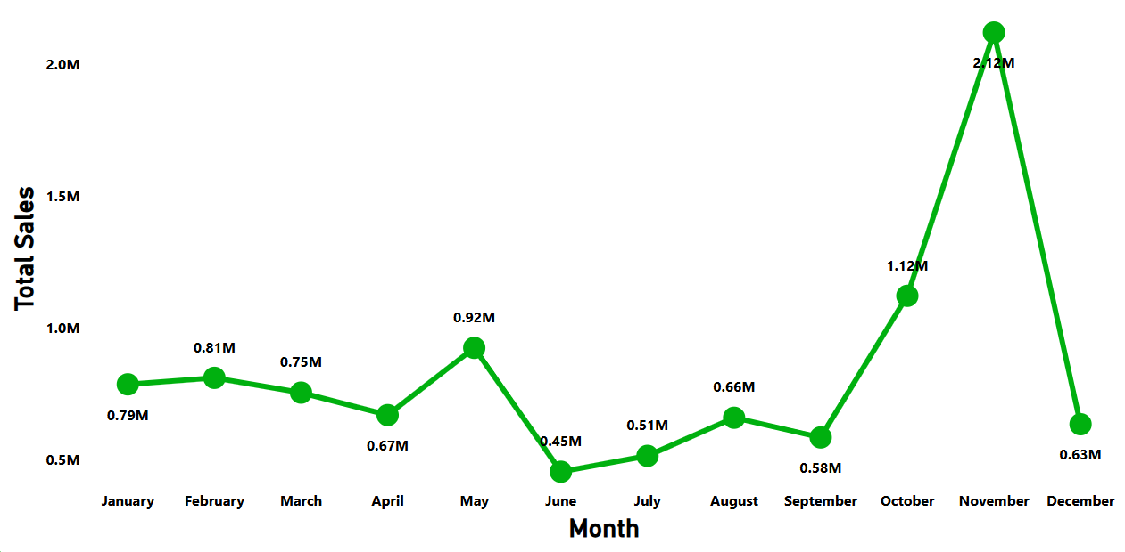
Total Sales by Month
Sales peaked in November at $2.12M, then dropped about 70% to $634K in December. This indicates possible seasonal trends. We should identify seasonal demand to optimize stock and campaign timing.
November
December

Slide 10
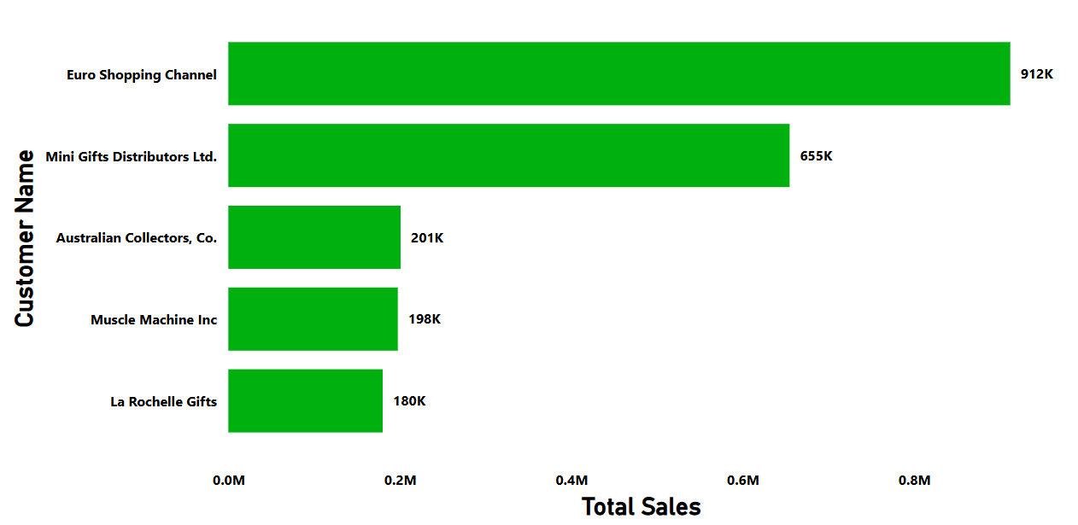
Top Customers by Revenue
Euro Shopping Channel and Mini Gifts Distributor Ltd. are our top customers, with purchases totaling over $912K and $655K, respectively. To retain their loyalty, we can offer loyalty programs and premium services.
Euro Shopping Channel
Mini Gifts Distributor Ltd.

Slide 11
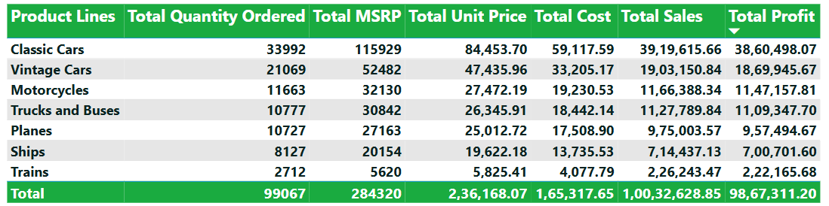
Product Line Summary Table
From the table, we observe that while Classic Cars generated the highest revenue and profit, Vintage Cars also performed strongly across all metrics. In contrast, Trains and Ships had significantly lower sales volume and profit, possibly indicating either lower demand or niche market positioning.
Classic Cars
Vintage Cars
Trains
Ships

Slide 12
Insights
Classic Cars dominate both in sales and profit, making them the most valuable product line for the business.
Vintage Cars follow closely in performance, with strong profit margins and high sales figures, indicating consistent customer demand.
Top-5 best-selling products are heavily concentrated in the Classic and Vintage Car categories, revalidating their market popularity.
Sales peak in November, suggesting the presence of seasonal demand or promotional campaigns during that time.
Euro Shopping Channel and Mini Gifts Distributor Ltd. are the top revenue-generating customers, contributing significantly to overall sales.
Trains category performs the weakest across all metrics: sales, profit, and quantity. These might need reevaluation in business strategy.
The overall profit margin appears strong, as total profit is nearly equal to total sales, suggesting efficient cost management.

Slide 13
Conclusion & Recommendations
The business is highly dependent on Classic and Vintage Cars. We should continue to focus marketing and inventory efforts on these top-performing product lines.
There's a significant sales spike in November. We should work on this trend with targeted seasonal promotions and campaigns.
Trains underperform across all metrics. Considering either improving product strategy or discontinuing the category after deeper evaluation would be effective.
Top customers like Euro Shopping Channel and Mini Gifts Distributor Ltd. should be promoted through loyalty programs or special deals to maintain and grow relationships.
High-profit margins across product lines indicate that existing cost control strategies are effective and should be sustained.
There's an opportunity to expand top-performing product lines into new customer segments based on historic trends.

Slide 14
Thank you
Nibedita Sahu
That’s a Wrap — Now Let’s Talk Data!

